Slide 1

Optimizing Cancer Detection – A Comparative Study of ML Classifiers
Name : Abu Hamza Khan

Slide 2
ABSTRACTION
This project focuses on the prediction of cancer using machine learning models and statistical analysis. We utilized a dataset of 1,500 patients containing various health and lifestyle factors.
We performed exploratory data analysis to understand data characteristics, then implemented models such as Logistic Regression, Random Forest, and Decision Tree to evaluate predictive accuracy.
The results showcase the comparative effectiveness of these models in predicting cancer risk, highlighting key patterns and factors associated with cancer diagnosis.

Slide 3
INTRODUCTION
Cancer is a major health concern worldwide, and early detection is crucial for improving patient outcomes.
Machine learning has become a powerful tool in healthcare, offering ways to predict diseases like cancer by analyzing patterns in clinical and lifestyle data.
This project explores and compares different ML algorithms – Logistic Regression, Random Forest, and Decision Tree– to classify individuals as Cancer or No Cancer using a dataset of key health indicators.

Slide 4
OBJECTIVE
The objectives of this study are:
Exploratory Data Analysis (EDA): Thoroughly understand and clean the cancer dataset.
Model Training: Train three ML models – Logistic Regression, Random Forest, and Decision Tree – on the data.
Performance Evaluation: Compare model performance based on key metrics (Accuracy, Confusion Matrix, Precision/Recall, etc.).
Insight Generation: Provide insights into the strengths and weaknesses of each model for cancer prediction.

Slide 5
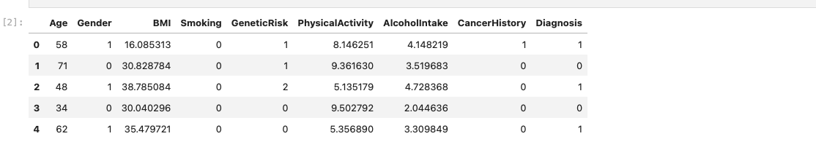
DATASET DESCRIPTION
The dataset includes medical and lifestyle features for 1,500 individuals: Age, Gender (0 = Male, 1 = Female), BMI(body mass index), Smoking (0/1), GeneticRisk (0 = low, 1 = medium, 2 = high), PhysicalActivity (exercise level), AlcoholIntake, CancerHistory (0/1 indicating prior cancer), and Diagnosis (target: 1 = Cancer, 0 = No Cancer).
Goal: Use these features to predict whether an individual is diagnosed with cancer or not.
Source: Kaggle – Cancer Prediction Dataset (a publicly available medical dataset for cancer diagnosis).

Slide 6
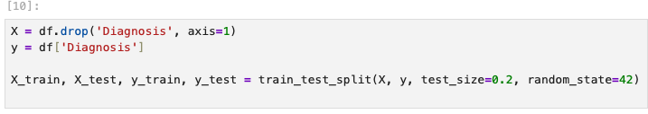
DATA PREPROCESSING
Data Splitting: The dataset was split into training and test sets (80% train, 20% test) to allow evaluation of model performance on unseen data. A stratified sampling approach preserved the Cancer/No-Cancer class proportion in both sets.
(All features were already numeric or encoded, so no additional encoding was required. No scaling was necessary for tree-based models; Logistic Regression handled features in their native ranges.)

Slide 7
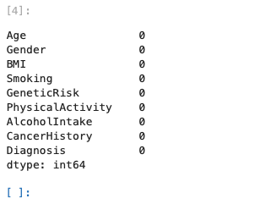
Data cleaning
No duplicate records were found in the dataset.
An initial check showed no missing values in any column, ensuring the dataset’s completeness and reliability for analysis.
Minimal preprocessing was needed since the data was already clean. We proceeded directly with analysis once data integrity was confirmed.

Slide 8
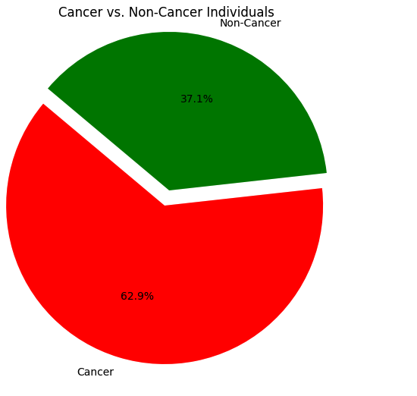
CANCER VS. NON-CANCER INDIVIDUALS
In the dataset, approximately 37.1% of patients are diagnosed with Cancer, while the remaining 62.9% are Non-Cancerindividuals.
This significant proportion of cancer cases underscores the importance of public health initiatives focused on prevention, early detection, and effective management of cancer (e.g., screening programs and patient education).
(Visualization: Pie chart showing the class distribution – slice for “Cancer” (~37%) vs “No Cancer” (~63%).)

Slide 9
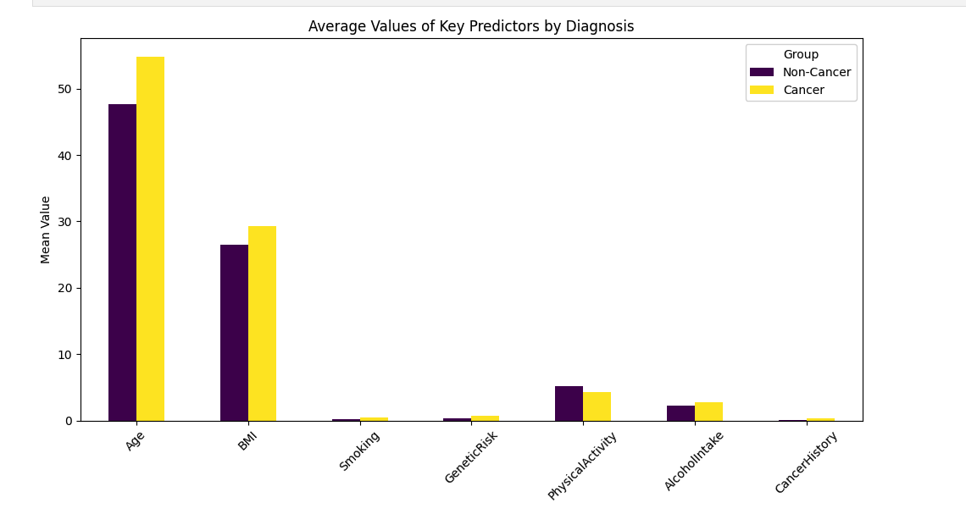
AVERAGE VALUES OF KEY PREDICTORS
Age: Average age is around 50 years. Older age is associated with higher cancer risk, and the dataset covers a wide age range (20–80), allowing analysis of age-related risk.
Gender: The dataset is roughly balanced between males and females. Both genders are represented, indicating that risk factors will be analyzed for their impact on both men and women.
BMI: Mean BMI is ~27.5 (in the overweight range). Higher BMI (overweight/obesity) is a known risk factor for certain cancers, suggesting that weight management may play a role in cancer risk.
Smoking: ~27% of individuals are smokers. Smoking is a major risk factor for cancer (especially lung cancer and others); its presence in the data provides insight into tobacco’s impact on cancer diagnosis.
GeneticRisk: Categorical score (0, 1, 2) with most patients having low risk. A higher genetic risk score indicates a stronger inherited predisposition to cancer, which can significantly increase an individual’s likelihood of diagnosis.
PhysicalActivity: Measured on a scale (0–10); average moderate activity level. Regular physical activity is generally protective, while low activity (sedentary lifestyle) can increase cancer risk.
AlcoholIntake: Moderate on average (scale 0–10). Heavy alcohol consumption is linked to increased risk of cancers (e.g., liver, colorectal); in this dataset most patients report low-to-moderate intake.
CancerHistory: ~15% of individuals have a prior history of cancer. A history of cancer greatly raises the risk of a new or recurrent cancer diagnosis, highlighting the need for careful monitoring of survivors.
(Visualization: Bar chart showing the mean value of each predictor in the dataset, to compare the relative magnitudes of Age, BMI, etc.)

Slide 10
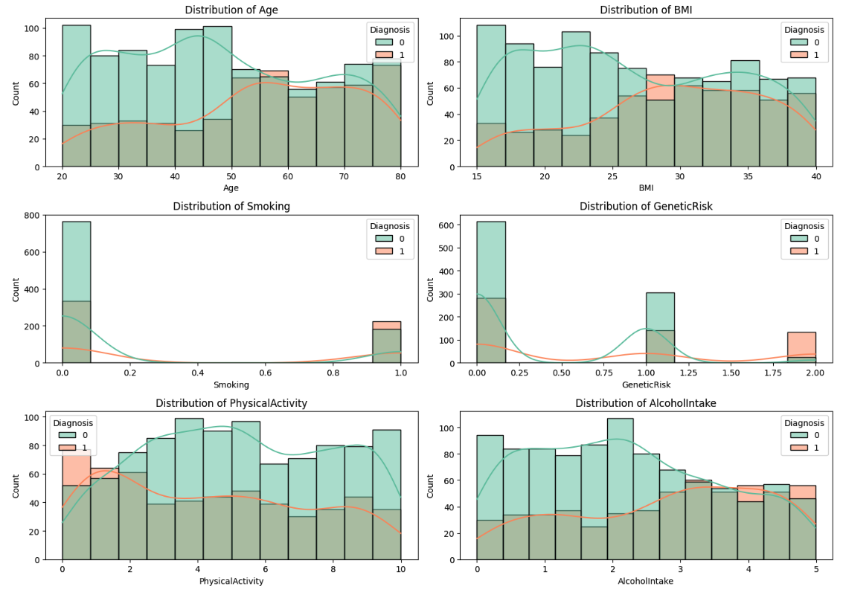
ANALYZING FACTORS INFLUENCING CANCER
Age Distribution: The age distribution spans young adults to elderly, with a higher concentration of individuals in middle-to-older age brackets. This slight right-skew toward older ages reflects the fact that cancer incidence increases with age.
BMI Distribution: BMI values are roughly bell-shaped, peaking in the overweight range (~25–30). The distribution has a right tail into the obese range, indicating that while many individuals are overweight, some reach high BMI levels (a potential risk factor).
PhysicalActivity & AlcoholIntake: Both of these lifestyle variables show right-skewed distributions. Many patients report low physical activity levels (sedentary lifestyle), and most have light to moderate alcohol intake. Only a few individuals are extremely active or heavy drinkers, indicating fewer cases at the healthy extreme of exercise or the unhealthy extreme of alcohol use.
GeneticRisk Levels: The genetic risk is skewed toward 0 (low risk) – a majority of patients have no known genetic predisposition. Fewer individuals fall into the high genetic risk category (2), which means strong hereditary cancer risk is less common in the dataset but still present in a subset.
(Visualization: Histograms for continuous variables – Age, BMI, PhysicalActivity, AlcoholIntake – showing their distribution. A bar chart for GeneticRisk levels 0/1/2 can be included to illustrate its frequency distribution.)

Slide 11
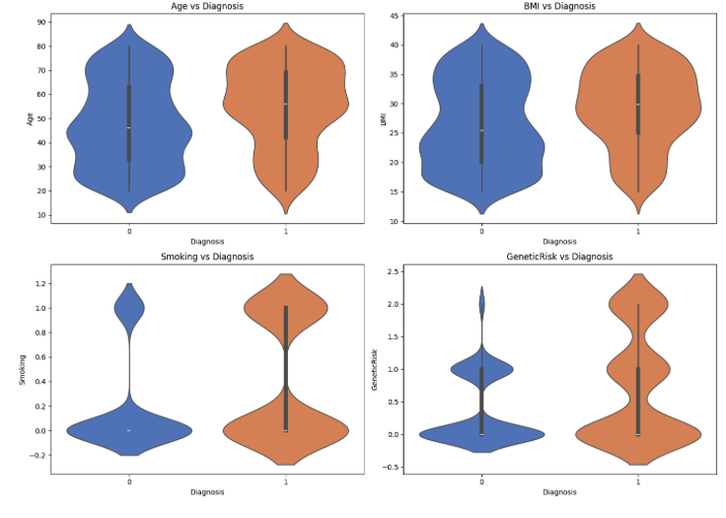
ANALYZING KEY RISK FACTORS FOR CANCERS
Genetic Predisposition & History: Patients diagnosed with cancer tend to have higher genetic risk scores and more frequently a prior cancer history. Individuals with a high GeneticRisk (2) or a CancerHistory are much more represented in the cancer group than in the no-cancer group, highlighting inherited and medical history as critical risk factors.
Age: The cancer group is notably older on average than the no-cancer group. Higher age is a significant factor – older individuals are more often affected by cancer, aligning with known increasing cancer incidence with age.
Smoking: A larger proportion of cancer patients are smokers compared to the non-cancer group. This confirms that tobacco use is a significant contributor to cancer risk in this dataset (many cancer patients have a history of smoking, a preventable risk factor).
BMI: Cancer patients have a slightly higher average BMI than those without cancer. This suggests that obesity may contribute to elevated cancer risk, though the effect is more modest compared to factors like smoking or genetic history.
Addressing these factors through lifestyle changes (e.g., smoking cessation, weight management) and regular screenings is essential. Mitigating modifiable risks and monitoring high-risk individuals (older or genetically predisposed) can help in cancer prevention and early detection.
(Visualization: Side-by-side comparison plots for Cancer vs No-Cancer groups – e.g., boxplots or violin plots – for key variables like Age, BMI, etc., to illustrate the differences in distributions between the two groups.)

Slide 12
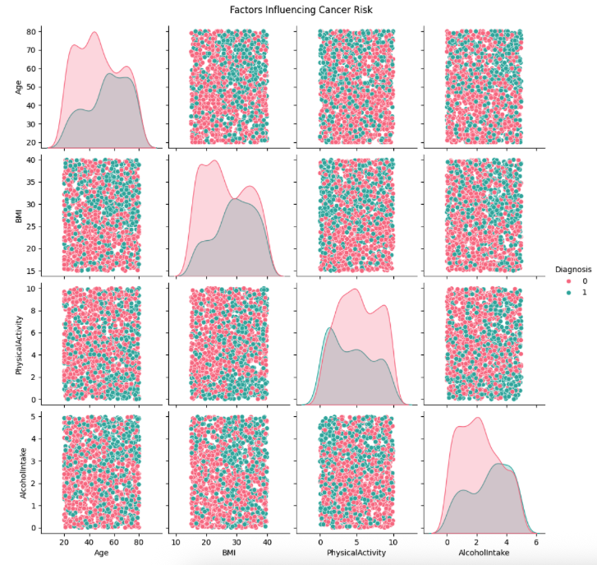
FACTORS INFLUENCING CANCER RISK (RELATIONSHIPS)
Smoking & Alcohol: There is a positive correlation between smoking and alcohol intake – patients who smoke often tend to consume more alcohol. This coupled behavior suggests a cluster of lifestyle risks, where tobacco and alcohol together could compound the overall cancer risk for those individuals.
Age & CancerHistory: Age correlates positively with cancer history. Older patients are far more likely to have had a prior cancer (simply because they’ve lived longer and had more exposure/opportunity). This relationship emphasizes that the elderly are at higher risk not only to develop cancer but potentially to have multiple occurrences over time.
Physical Activity & BMI: An inverse relationship is observed between exercise and BMI – individuals with higher physical activity levels generally have lower BMI. In contrast, many cancer patients fall into the pattern of low activity and higher BMI. This combination (sedentary lifestyle + obesity) is a notable risk profile contributing to cancer incidence.
Interpreting Relationships: These relationships highlight the need for targeted interventions. For example, patients who smoke and drink should be prioritized for risk-reduction programs, and those who are older or genetically high-risk might need more frequent screenings. Encouraging active lifestyles and healthy weight management can be an effective strategy to lower cancer risk in the broader population.
(Visualization: Scatter plot matrix (pairplot) showing pairwise relationships between key variables like Age, BMI, PhysicalActivity, etc., with points colored by Diagnosis (orange = Cancer, blue = No Cancer). This reveals clusters/patterns such as low-activity & high-BMI clustering among cancer cases.)

Slide 13
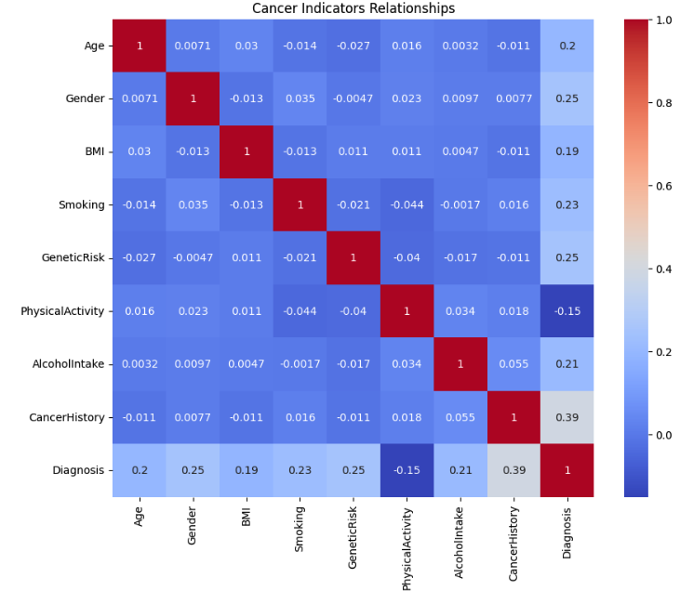
CANCER INDICATORS RELATIONSHIPS(CORRELATION ANALYSIS)
The correlation matrix of features provides further insight into how variables relate to each other:
Smoking & Alcohol Intake: Moderately positive correlation (≈ +0.4). This confirms that higher alcohol consumption often coincides with smoking – a synergy of risk behaviors relevant for cancer.
Age & CancerHistory: Strong positive correlation (≈ +0.5). Older individuals more frequently have a history of cancer, which is expected as age increases cumulative exposure to risk factors and time for cancer development.
PhysicalActivity & BMI: Noticeable negative correlation (≈ –0.3). People who are more physically active tend to have lower BMI. This relationship underscores the link between sedentary lifestyle and higher body weight, both influencing cancer risk.
Minimal Other Correlations: Most other feature pairs show weak or negligible correlations. For instance, Genderhas virtually no correlation with other predictors or with diagnosis in this dataset, indicating that cancer risk factors here largely operate independently of patient sex.
(Visualization: Correlation heatmap for all features (Age, BMI, etc.), with correlation coefficients annotated. Key correlations (e.g., Smoking vs Alcohol, Age vs CancerHistory) can be highlighted to show these relationships.)

Slide 14
LITERATURE REVIEW
Prior research in cancer prediction demonstrates the successful use of logistic regression and tree-based models in medical diagnostics​file-a2j7peclaud1mmpxv5yffx. Studies indicate that incorporating genetic, lifestyle, and clinical features into machine learning models can significantly improve early cancer detection.
Ensemble methods like Random Forest and boosted trees have been shown to capture complex non-linear interactions among risk factors, often outperforming simple models in accuracy​file-a2j7peclaud1mmpxv5yffx. These models handle high-dimensional data and feature interactions effectively, which is beneficial for modeling multifactorial diseases like cancer.
Logistic regression, while simpler, provides a strong baseline and interpretability – it models linear relationships between risk factors and outcome​file-a2j7peclaud1mmpxv5yffx. It’s frequently used in biomedical studies for its ease of interpretation (odds ratios) and can perform well when relationships are mostly linear.
Overall, the literature suggests combining data-driven ML approaches with domain knowledge (e.g. known risk factors) yields the best results in predicting cancer outcomes, guiding our choice of models and methodology.

Slide 15
ARCHITECTURE/METHODOLOGY
Exploratory Data Analysis (EDA): We first visualized the data distributions, relationships, and correlations among features to understand underlying patterns and ensure data quality​file-a2j7peclaud1mmpxv5yffx.
Feature Analysis: Key predictors (such as Age, GeneticRisk, Smoking, BMI, etc.) were identified and examined for their individual influence on cancer diagnosis. No features were removed, but this step ensured our focus on the most relevant variables.
Model Training: We built and trained three different classifiers:
Logistic Regression: A linear model for binary classification (baseline model for cancer vs no cancer).
Random Forest Classifier: An ensemble of decision trees to capture non-linear relationships and reduce overfitting via averaging.
Decision Tree Classifier: A single decision tree for interpretable flow-chart-like decision rules.
Evaluation Metrics: Model performance was evaluated using Accuracy (overall correctness), Precision & Recall for each class (from the classification report), Confusion Matrix (to examine true/false positives and negatives), and the ROC Curve & AUC score (to assess classification threshold performance)​file-a2j7peclaud1mmpxv5yffx​file-a2j7peclaud1mmpxv5yffx.
(Visualization: A flowchart diagram illustrating the methodology pipeline – EDA ➔ Feature Analysis ➔ Model Training (3 models) ➔ Evaluation (metrics like accuracy, ROC-AUC, etc.).)

Slide 16
RESULTS

Slide 17
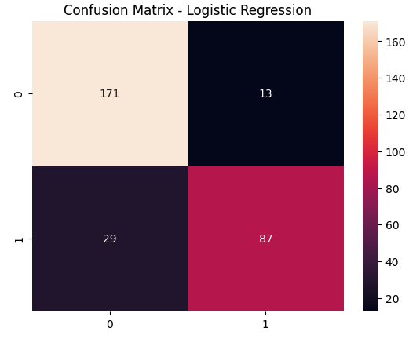
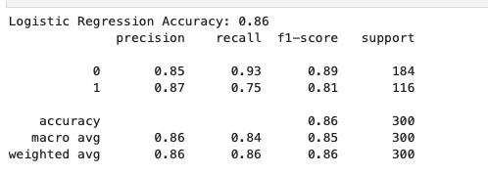
LOGISTIC REGRESSION
Overall Accuracy: Logistic Regression achieved an accuracy of 86%, indicating strong model performance on cancer diagnosis prediction.
Class 0 (Non-Cancer / Benign):
Precision: 85% (model correctly identifies 85% of benign cases)
Recall: 93% (model captures 93% of actual benign cases)
F1-Score: 89%
Class 1 (Cancer / Malignant):
Precision: 87% (model correctly identifies 87% of malignant cases)
Recall: 75% (model captures 75% of actual malignant cases)
F1-Score: 81%
Macro Average: Balanced performance across classes with macro precision of 86% and macro recall of 84%.
Weighted Average: Weighted overall F1-score is 86%, showing reliable generalization across imbalanced classes.
Confusion Matrix Insights:
True Negatives (TN): 171 (Benign cases correctly predicted)
True Positives (TP): 87 (Malignant cases correctly predicted)
False Positives (FP): 13 (Benign cases misclassified as malignant)
False Negatives (FN): 29 (Malignant cases missed)
The model shows high specificity (few false positives) and good sensitivity for detecting cancer, though some malignant cases are missed.

Slide 18
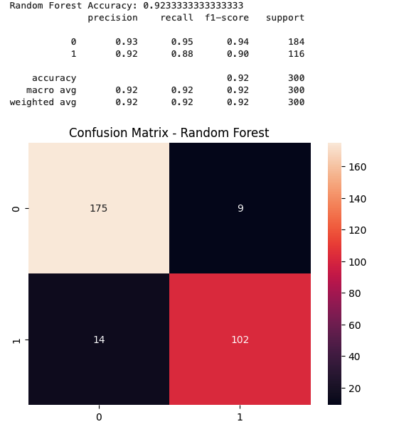
RANDOM FOREST CLASSIFIER
Overall Accuracy: Random Forest achieved a high accuracy of 92%, indicating excellent predictive performance on cancer diagnosis.
Class 0 (Non-Cancer / Benign):
Precision: 93% (model correctly identifies 93% of benign cases)
Recall: 95% (model captures 95% of actual benign cases)
F1-Score: 94%
Class 1 (Cancer / Malignant):
Precision: 92% (model correctly identifies 92% of malignant cases)
Recall: 88% (model captures 88% of actual malignant cases)
F1-Score: 90%
Macro Average: Macro precision and recall both stand at 92%, showing balanced model behavior across both classes.
Weighted Average: Overall weighted F1-score of 92%, demonstrating strong consistency even in imbalanced data.
Confusion Matrix Insights:
True Negatives (TN): 175 (Benign cases correctly classified)
True Positives (TP): 102 (Malignant cases correctly classified)
False Positives (FP): 9 (Benign cases misclassified as malignant)
False Negatives (FN): 14 (Malignant cases missed)
The model shows high specificity (low false positives) and very strong sensitivity for detecting cancer cases.

Slide 19
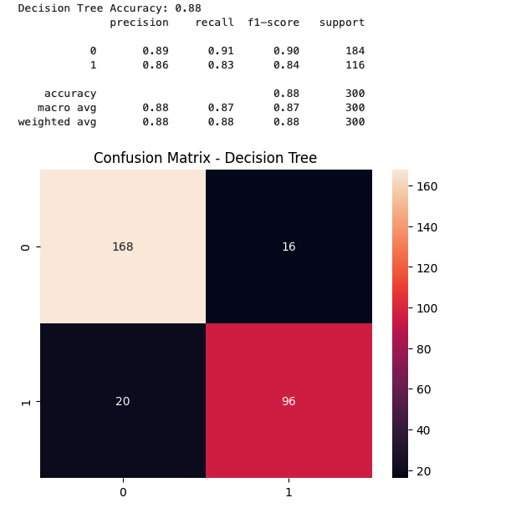
DECISION TREE CLASSIFIER
Overall Accuracy: The Decision Tree classifier achieved an accuracy of 88%, demonstrating strong overall performance.
Class 0 (Non-Cancer / Benign):
Precision: 89% (model correctly identifies 89% of benign cases)
Recall: 91% (model captures 91% of actual benign cases)
F1-Score: 90%
Class 1 (Cancer / Malignant):
Precision: 86% (model correctly identifies 86% of malignant cases)
Recall: 83% (model captures 83% of actual malignant cases)
F1-Score: 84%
Macro Average: Macro precision and recall are 88% and 87% respectively, indicating balanced classification performance.
Weighted Average: The weighted F1-score is 88%, reflecting consistent performance across both classes.
Confusion Matrix Insights:
True Negatives (TN): 168 (Benign cases correctly classified)
True Positives (TP): 96 (Malignant cases correctly classified)
False Positives (FP): 16 (Benign cases misclassified as malignant)
False Negatives (FN): 20 (Malignant cases missed)

Slide 20
MODEL COMPARISION
METRIC | LOGISTIC REGRESSION | RANDOM FOREST | DECISION TREE
ACCURACY | 86% | 92% | 88%
PRECISION (class 1) | 87% | 92% | 86%
RECALL (class 1) | 75% | 88% | 83%
F1-SCORE (class 1) | 81% | 90% | 84%
TRUE POSITIVES (TP) | 87% | 102% | 96%
FALSE NEGATIVES (FN) | 29% | 14% | 20%
FALSE POSITIVE (FP) | 13% | 9% | 16%

Slide 21
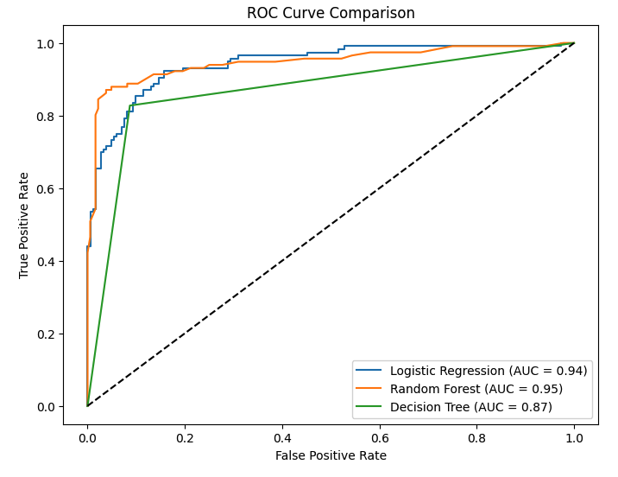
MODEL COMPARISION
Random Forest:
Achieved the highest AUC score of 0.95, indicating excellent classification capability and strong model reliability.
Logistic Regression:
Obtained an AUC of 0.94, very close to Random Forest, reflecting very good discrimination between cancerous and non-cancerous cases.
Decision Tree:
Scored an AUC of 0.87, performing lower compared to the ensemble models but still providing reasonable separation between classes.
ROC Analysis Insight:
Both Logistic Regression and Random Forest showed near-perfect ROC curves, staying close to the top-left corner.
Decision Tree curve was slightly lower, indicating slightly reduced sensitivity and specificity compared to the other two models.

Slide 22
CONCLUSION
In this project, multiple machine learning models were applied to predict cancer diagnosis based on patient data.
Random Forest outperformed all other models, achieving the highest accuracy (92%), best recall (88%), and the highest AUC score (0.95), making it the most reliable model for cancer prediction in this study.
Logistic Regression also performed very well with an accuracy of 86% and an AUC of 0.94, indicating strong discriminative power, though it had slightly lower recall compared to Random Forest.
Decision Tree showed good performance with 88% accuracy but was comparatively less robust than the ensemble method (Random Forest) in handling complex patterns.
ROC Curve analysis confirmed that ensemble learning (Random Forest) provides better sensitivity and specificity balance compared to individual models.
Overall, ensemble methods like Random Forest can significantly improve cancer detection rates and minimize false negatives, which is crucial for early diagnosis and patient survival.

Slide 23
FUTURE RECOMMENDATIONS
Hyperparameter Tuning: Apply advanced hyperparameter tuning methods such as Grid Search and Randomized Search to optimize model performance.
Advanced Models: Explore the use of Deep Learning architectures or Ensemble methods like XGBoost, LightGBM, and AutoML frameworks to further enhance prediction accuracy.
Feature Engineering: Implement sophisticated feature selection and extraction techniques to reduce noise, improve model interpretability, and increase overall efficiency.
External Validation: Validate models using independent external datasets to ensure robustness and generalizability across diverse patient populations.
Real-world Deployment: Develop a scalable clinical decision support system integrating the best-performing model for real-time cancer diagnosis assistance.

Slide 24
REFERENCES
National Cancer Institute (NCI): “Cancer Statistics and Research.” – Comprehensive statistics on cancer incidence and risk factors, providing context for age and lifestyle risk relationships in our analysis.
Kaggle – Cancer Prediction Dataset: (Rabie Elkharoua) – Source of the dataset used in this project, containing the 1,500 patient records of health indicators and cancer diagnoses.
Scikit-learn Documentation: Machine learning algorithm references for Logistic Regression, Random Forest, Decision Tree – used for model implementation and evaluation methods (version 0.24+).
Kaggle Notebooks (Cancer Prediction): Community-contributed analyses on similar cancer datasets – used for comparative insights and validation of modeling approaches.
American Cancer Society (ACS): “Cancer Facts & Figures 2025.” – Provides epidemiological data on cancer and emphasizes the importance of risk factors such as smoking, obesity, and genetics in cancer incidence.

Slide 25
GITHUB REPOSITORY FOR CODE
https://github.com/Hamzakhan7473/CancerAnalytics-/blob/main/Canseranalytics.ipynb

